Slide 1
Senior Care Receiverships
CRA Webinar // February 27, 2024

Slide 2
Introduction

Slide 3
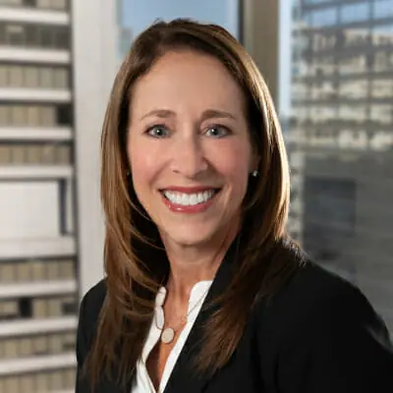
Jennifer Meyerowitz
Chief Growth Officer & GC
SAK Healthcare
jmeyerowitz@sakhealthcare.com

Slide 4
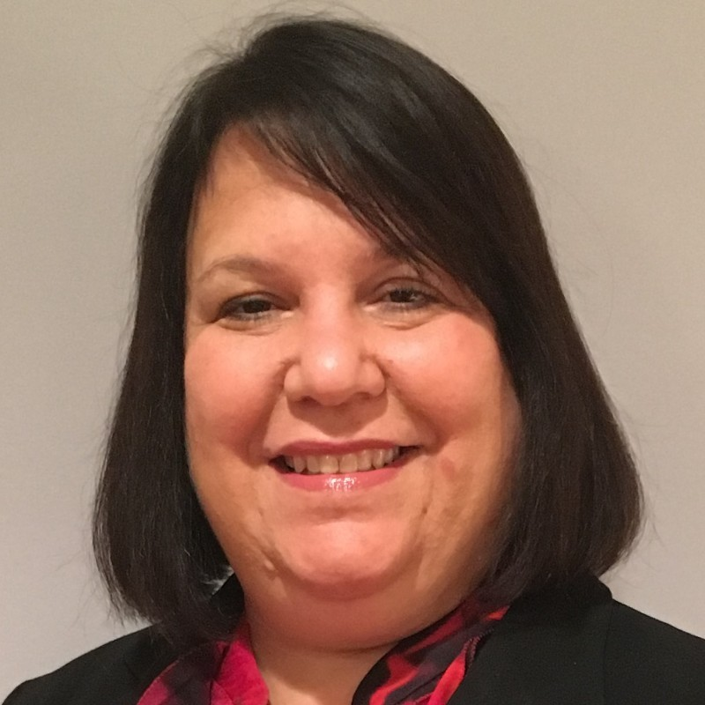
Kim Gordon
Senior Managing Director
MonticelloAM
kgordon@monticelloam.com

Slide 5
Megan Murray
Shareholder
Underwood Murray
mmurray@underwoodmurray.com

Slide 6
Jeremy Stroiman
CEO
Evans Senior Investments
jeremy.stroiman@evanssenior.com

Slide 7
Background
State of the Industry
SKILLED NURSING & SENIORS HOUSING IN 2024

Slide 8
Current Economic Climate
INTEREST RATES, INFLATION, AND THE DEBT MARKET
US Inflation Rate currently stands at 3.09%, compared to 6.41% last year and Interest Rates are widely expected to be decreased in 2024.
We have already seen a resurgence in REIT and Private Equity acquisition activity in both Seniors and Skilled and expect this to continue throughout 2024.

Slide 9
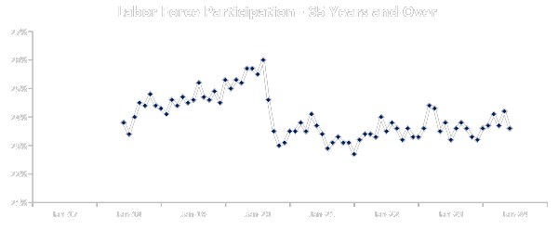
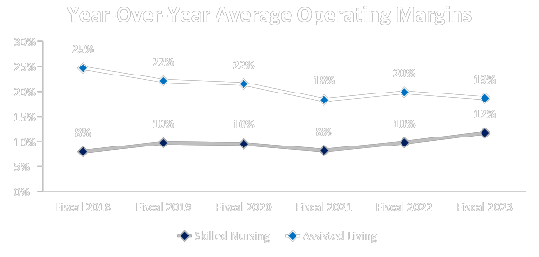
INDUSTRY TRENDS: HEADWINDS
Skilled Nursing Industry
Labor Continues to Be the Largest Challenge
CMS Announces Staffing Mandate for Nursing Homes
$6.8B
President Biden’s New Proposal Could Require Up To 80% Of Medicaid To Be Directed To Compensating Direct Care Workers
“Over the next decade, the number of people of working age (between ages 15 and 65) will decline in the U.S. by over 3 percent.” - World Bank
Senior Housing Industry

Slide 10
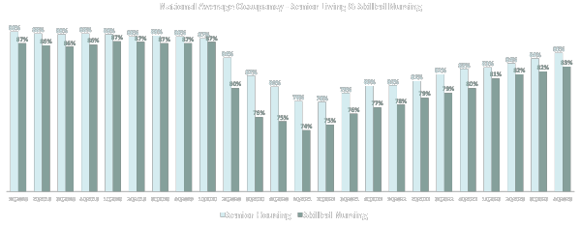
INDUSTRY AS A WHOLE: Positive Occupancy Trends
Both sectors expected to fully recover to pre-pandemic levels driven by the inevitable increase in demand from an aging us population.

Slide 11
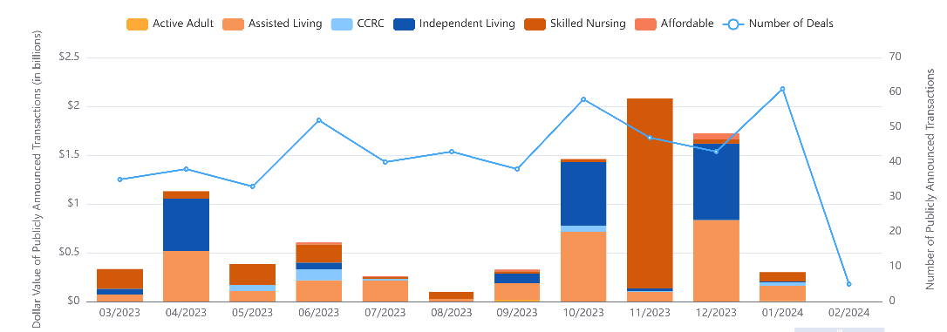
INDUSTRY AS A WHOLE: Monthly Transaction Volume by Type

Slide 12
Senior Care - Why a Receivership?

Slide 13
Critical Issues
Deteriorating Cash Flow
Clinical Issues/Quality of Care
Need to Replace Operator
Possible Loss of License
Control Cash/Cash Leakage

Slide 14
Legal Considerations

Slide 15
Motion To Appoint
A Receiver
Consider your basis
Waste?
Cause?
Loan Docs?

Slide 16
Alternatives?
Foreclosure
Bankruptcy
Workout
Cost Considerations

Slide 17
Lender’s Perspective
Independent Third Party
Control of Cash Flow
Transition to New Operator

Slide 18
What Is In The Receivership?
Property?
Company?
Opco/Propco
License
Other?

Slide 19
Additional Healthcare Issues
State Law
Insurance
Rental
Foreclosure
Real Property
Healthcare
Federal Law
HIPPA

Slide 20
…Receivership Order
Insurance
Bond
Counsel
License Issues
Liens and taxes
Licensing
Rights
Indemnification
Notices
Court Approval

Slide 21
Reporting To The Court and Creditors
Receivership Report
Fee Approval
Termination
Look at State Law

Slide 22
Operational Issues In Senior Living

Slide 23
Operational Issues in Senior Housing
Triage
Immediate Considerations

Slide 24
Operational Issues in Senior Housing
Health & Safety of Residents
Labor/Staffing Needs
Major Contracts
Financials
Clinical Care and Clinical Records
Regulatory Issues/Fines
Facility & CapEx Needs
Census
Insurance
Communication
Litigation

Slide 25
Operational Issues In Senior Housing
Health & Safety Of Residents

Slide 26
Operational Issues In Senior Housing
Labor & Staffing
Very labor dependent delivery model
Many low skilled positions
Costly and inefficient delivery model
Talent shortages
Competition for some positions from outside the industry
Lack of automation and low use of technology/AI
Rural vs. urban labor supply
Agency
Increase in supply of Interim role

Slide 27
Operational Issues In Senior Housing
Major Contracts
Agency
Food Supply
Medical Supply
Pharmacy
Therapy
Secondary Contracts
Television
Equipment
Laundry/Housekeeping

Slide 28
Operational Issues In Senior Housing
Financial Issues
Lack of financials
Chaos in Back Office
Vendor holds
Cash Flow
Bad Debt/Uncollectible Receivables
Slow Reimbursements from Medicare/Medicaid
Rates and Acuity

Slide 29
Operational Issues In Senior Housing
Clinical and Clinical Records
CARE of Residents’ Paramount
Policies
Medical Director
Admission Reviews
DON and ADON
Software for Recording Clinical Notes
Example PCC
Regulatory
MDS/PDPM Tracking
Affects Reimbursement Rates

Slide 30
Operational Issues In Senior Housing
Regulatory Concerns
Surveys - “Gotcha Surveyors”
Fines
Decertification
Cash Holds
Mock Surveys
Time and Focus of Surveyors/Regulators
Examples:
Counter ½” away from Wall
Door not locked
Pureed food
Staffing Shortages

Slide 31
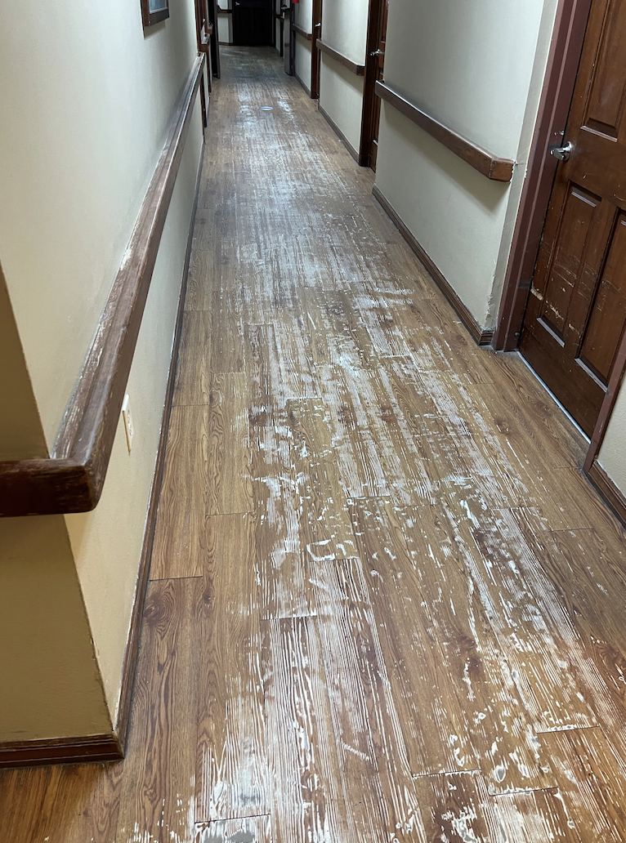
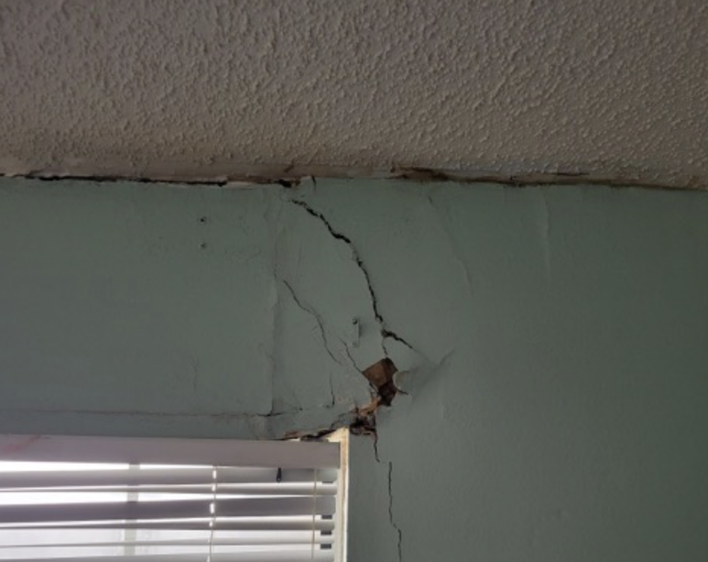
Operational Issues In Senior Housing
Facility & CapEx Needs
Needs vs. Wants
Roofs
Kitchen Equipment
Furniture
Landscape
Painting
Carpet

Slide 32
Operational Issues In Senior Housing
Census
Buildings not full, why?
Marketing programs / Incentives
Rates
Referral Sources
CapEx concerns
Staff
Food

Slide 33
Operational Issues In Senior Housing
Insurance Needs
Names Insured
Property & Liability
Cancellation Notices
Expert Brokers Essential

Slide 34
Operational Issues In Senior Housing
Communication to Staff
Executive Director / Administrator First
Retention is Key
Meeting of Staff
Transparency
Confidence

Slide 35
Operational Issues In Senior Housing
Litigation
Med Malpractice Claims
Employment Claims
BIPA

Slide 36
Solutions
Get a handle on Labor Needs, Rates
Get rid of Agency
Get control of regulatory concerns and no fines; clean surveys
Access all contracts / vendors / payment terms
CapEx - Clean up facility
Build Census
Utilize Technology
Training / Encouragement / Enforcement / Communication / Follow Up

Slide 37
Valuation Analysis & The Sales Process

Slide 38
1
Confidentially provide ESI with your facility’s trailing 12-month financial statements.
Valuation
Analysis
2
ESI Analyst Team builds financial models analyzing data and compares your facility to industry.
3
ESI delivers 20+ page market report with industry information and market valuation.
4
We will discuss best possible market strategies specific to your facility with Q&A with your leadership team.

Slide 39
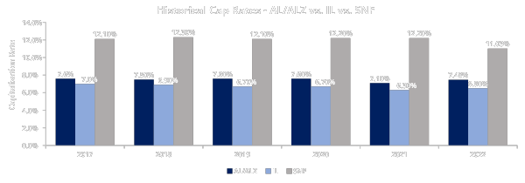
CAPITALIZATION RATES
WHAT IS A CAP RATE?
A capitalization rate is a ratio of a property’s net operating income (NOI) to its market value, much like the inverse of a price to earnings (PE) ratio in the stock market.
Investors use capitalization rates to measure the required return for the forecasted risk of an asset.
A higher capitalization rate denotes greater risk and therefore requires a higher return.
Capitalization rates for skilled nursing and senior living facilities have trended in the range of 4.0% - 14.0% in 2022, with the large variances in the cap rate range due to location, size, age of facility, room layout (private rooms vs shared), and occupancy.

Slide 40
VALUATION EXMAPLE
BENCHMARKING VALUE INCREASE
ESI CURRENT MARKET VALUE:
SKILLED NURSING
$2,983,972
12.50%
$23,900,000
$100,000
SENIORS HOUSING
$1,765,144
8.00%
$22,100,000
$266,000
COMMUNITY
NET OPERATING INCOME
(ESI Pro-Forma)
CAPITLIZATION RATE
ASSET VALUE
PER BED/UNIT VALUE
CASHFLOW VALUE:
SKILLED NURSING
$591,260
12.50%
$4,700,000
$20,000
SENIORS HOUSING
$1,449,699
8.00%
$18,100,000
$218,000
COMMUNITY
NET OPERATING INCOME
(Trailing Twelve Months)
CAPITLIZATION RATE
ASSET VALUE
PER BED/UNIT VALUE

Slide 41
THE ASSIGNMENT
Maximize our client’s success opportunity by adhering to three goals:
Securing the highest possible sales price
Transacting as quickly as possible
Creating a confidential marketing process

Slide 42
TYPICAL TRANSACTION TIMELINE
ESI Prepares Offering Memorandum upon receipt of all requested materials
ESI markets the facility to select group of buyers
Avg. 3 Weeks
Buyer Selected
ESI analyzes LOIs and ask for 2nd round bids if applicable. Winning buyer is selected.
Avg. 15 Days
APA Signed
Earnest Money Nonrefundable
Asset Purchase and Sale Agreement is negotiated.
Avg. 30 Days
Buyer’s Due Diligence period begins and ends with earnest money deposit.
Avg. 60 Days
Third party reports and site visits are coordinated.
Avg. 45 Days
License Transfer and CHOW filed with regulatory bodies.
Avg. 45 Days
Announcement to staff and deal closes
Avg. 15 Days
Rep Agreement Signed
15 Days
30 Days
45 Days
60 Days
75 Days
90 Days
105
Days
120
Days
135
Days
150
Days

Slide 43
Additional Information
All panels will be available to members on an ongoing basis in the CRA online library.
There are a number of local in-person events coming this spring check your state page on the CRA website for more info (www.commercialreceiver.org/state).
Our next Members webinar is “What’s Happening in CRE Receiverships?” and will take place 5/8.
Annual CRA Conference upcoming this August at Eau Palm Beach Resort & Spa 8/18-8/21!

Slide 44
Thank You!

